Slide 1





Object-Oriented Programming in Java
How Java Implements OOP: Classes, Objects, Exceptions, Etc.
Svetlin Nakov
Technical Trainer
Java OOP
www.nakov.com
Software University
http://softuni.bg

Slide 2

Table of Contents
Classes
Fields, Properties, Methods, Constructors, Constants, Access Modifiers, Encapsulation, Static Members
Interfaces and Abstract Classes
Inheritance and Polymorphism
Packages, Static Import, Generics
Exceptions, Enumerations, Annotations
Functional Programming: Lambda Functions and Streams
java.lang.Object, Iterable<T>, Iterator<E>, Comparable<T>

Slide 3
Classes in Java
Fields
public class Student {
private String name;
private int age;
public Student(String name, int age) {
this.name = name;
this.age = age;
}
public String getName() {
return name;
}
public void setName(String name) {
this.name = name;
}
…
}
Constructors
Properties:
getter + setter

Slide 4
Properties in Java
Java has no special syntax for properties
It uses pairs of getter / setter methods
Getters: getXXX() / isXXX()
Setters: setXXX()
public int getAge() {
return age;
}
public boolean isLocal() {
return local;
}
public void setName(String name) {
this.name = name;
}

Slide 5
Constructors and Chaining
Constructors can be chained (called one from another):
public class Student {
private String name;
private int age;
private boolean local = false;
public Student(String name, int age, boolean local) {
this.setName(name);
this.setAge(age);
this.setLocal(local);
}
public Student(String name, int age) {
this(name, age, false);
}
…
}
Use this(…) to call another constructor from the same class and super(…) to call a constructor from the parent class.

Slide 6

Access Modifiers
Java supports access modifiers
To restrict the class members visibility
Class members can be:
public – accessible from any class
protected – accessible from the class itself and all its descendent classes
(no modifier) – package-level visibility (default)
private – accessible from the class itself only

Slide 7
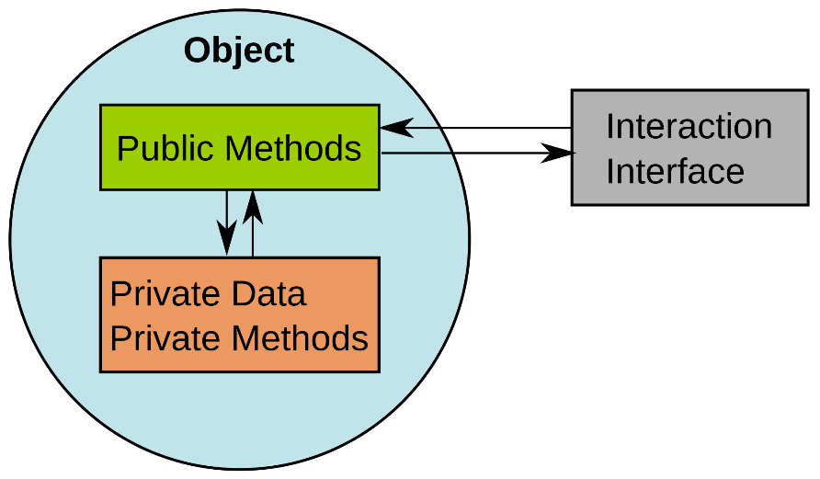
Encapsulation
Java supports classical encapsulation:
Private field + public getter / setter / constructors around it
public class Student {
private String name;
public Student(String name) {
this.setName(name);
}
public String getName() {
return name;
}
public void setName(String name) {
if (name == null || name.length() == 0) {
throw new IllegalArgumentException(
"Name cannot be empty");
}
this.name = name;
}
…
}

Slide 8
Methods
Methods in Java are similar to methods in C#
No default parameter values
No extension methods
Formatting conventions
Use camelCase naming
The { always stays on the same line
public void incrementAge(int p) {
this.age = this.age + p;
}
public String toJson() {
Gson gson = new Gson();
String json = gson.toJson(this);
return json;
}

Slide 9
Static Members and Constants
Java supports static members: fields, methods, constructors
private static final String iconFileName = "student-icon.png";
private static byte[] icon;
static {
icon = loadIcon(iconFileName);
}
public static byte[] getIcon() {
return icon;
}
Static field
Constant
Static constructor
Static method

Slide 10

Interfaces
Interfaces define a set of operations
Similar to C# and C++ interfaces
Naming pattern: [Verb] + "able"
public interface Movable {
public void move(double deltaX, double deltaY);
}
public interface AreaCalculatable {
public double calculateArea();
}

Slide 11
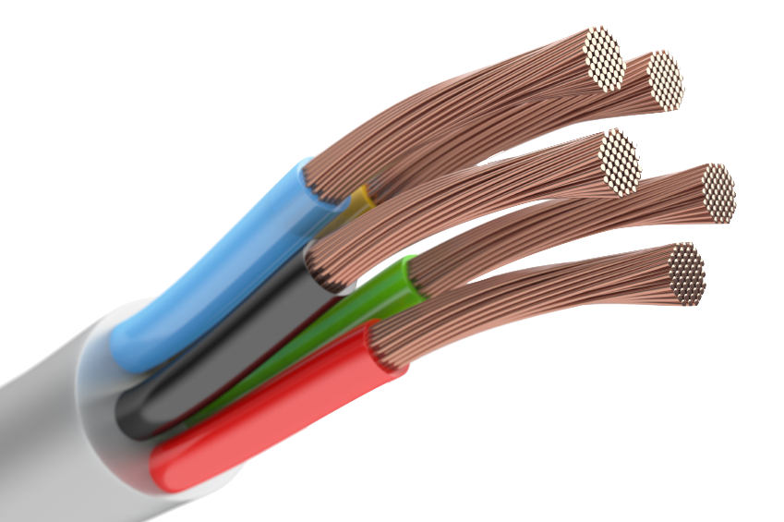
Implementing an Interface
public class Ball implements Movable {
private double x = 0;
private double y = 0;
public double getX() { return x; }
public void setX(double x) { this.x = x; }
public double getY() { return y; }
public void setY(double y) { this.y = y; }
@Override
public void move(double deltaX, double deltaY) {
this.x += deltaX;
this.y += deltaY;
}
}
The @Override annotation is not mandatory. It is a compiler hint.

Slide 12
Abstract Classes
Java supports abstract classes (partially implemented classes)
public abstract class Shape implements Movable, AreaCalculatable {
protected double x = 0;
protected double y = 0;
@Override
public void move(double deltaX, double deltaY) {
this.x += deltaX;
this.y += deltaY;
}
// The method calculateArea() is intentionally left abstract
}

Slide 13
Inheritance
Java supports classical OOP inheritance
public class Circle extends Shape {
private double radius;
public Circle(double x, double y, double radius) {
super(x, y);
this.radius = radius;
}
@Override
public double calculateArea() {
return Math.PI * this.radius * this.radius;
}
}
Call to a parent constructor
Override a virtual method

Slide 14
Overriding Virtual Methods
In Java all methods are virtual (unless declared final)
Descendent classes can freely override their implementation
public class Circle extends Shape {
…
@Override
public double calculateArea() {
return Math.PI * this.radius * this.radius;
}
@Override
public String toString() {
return "Circle(" + x + ", " + y + ", r=" + radius + ")";
}
}
Using @Override annotation is non-mandatory

Slide 15
Polymorphism
Java supports classical OOP polymorphism
Shape[] shapes = new Shape[] {
new Circle(5, 8, 12),
new Rectangle(3, 7, 10, 5),
new Rectangle(-1.5, 0, 2, 6),
new Circle(0, 0, 2.5)
};
for (Shape shape : shapes) {
System.out.println(shape + " -> " + shape.calculateArea());
}
Due to polymorphism, Shape variables can hold Circle and Rectangle objects
Invoke abstract actions, implemented in a subclass

Slide 16
Enumerations
Enumerations (enums) in Java are special classes that hold a set of predefined constants:
public enum Day {
SUNDAY, MONDAY, TUESDAY, WEDNESDAY,
THURSDAY, FRIDAY, SATURDAY
}
Day d = Day.MONDAY;
if (d == Day.MONDAY) {
System.out.println(d); // MONDAY
System.out.println(d.ordinal()); // 1
}

Slide 17
Generic Classes
Java supports pseudo-generic classes (syntactic sugar only)
Implemented by "type erasure" → all type parameters are replaced by Object during the compilation
List<int> not supported, you should use List<Integer>
public class Pair<T1, T2> {
private T1 first;
private T2 second;
public Pair(T1 first, T2 second) { … }
}

Slide 18
Generic Lists
Java supports generic lists by erasing their type:
List<String> strings = Arrays.asList("OOP", "Java", "class");
System.out.println(strings); // [OOP, Java, class]
List<Integer> nums = new ArrayList<>();
nums.addAll(Arrays.asList(10, 20, 30));
// nums.add("Hello"); // Compile-time error
((List)nums).add("Hello"); // This works!
System.out.println(nums); // [10, 20, 30, Hello]
for (int num : nums) // java.lang.ClassCastException
System.out.println(num);

Slide 19
Packages
Packages in Java hold a set of types (classes, interfaces, enumerations) and sub-packages
Put the classes in org/example/shapes subdirectory
org/example/shapes/Shape.java
package org.example.shapes;
public abstract class Shape { … }
package org.example.shapes;
public class Circle { … }
org/example/shapes/Circle.java
package org.example.shapes;
public class Rectangle { … }
org/example/shapes/Rectangle.java

Slide 20
Importing Packages
Using classes by full name (package name + class name):
Importing a single class:
Importing all classes from the certain package:
java.util.List<Integer> list = java.util.Arrays.asList(5, 6, 7);
import java.util.List;
import java.util.Arrays;
List<Integer> list = Arrays.asList(5, 6, 7);
import java.util.*;
List<Integer> list = Arrays.asList(5, 6, 7);

Slide 21
Static Import
Static import allows using a static method from a class directly without specifying the class name:
import java.util.List;
import static java.util.Arrays.asList;
List<Integer> list = asList(5, 6, 7); // Arrays.asList
import java.util.*;
import static java.util.Arrays.*;
List<Integer> list = asList(5, 6, 7); // Arrays.asList

Slide 22
Exception Handling
Java supports the classical try-catch-finally construct:
String num = "hello";
try {
int i = Integer.parseInt(num);
System.out.println(i);
} catch (NumberFormatException ex) {
System.err.println(ex);
} finally {
System.out.println("This is always printed.");
}

Slide 23
Checked and Unchecked Exceptions
Checked exception are required to be handled or should be declared to be thrown
Unchecked exceptions (runtime exceptions) can be handled optionally:
int i = System.in.read(); // This will not compile!
try {
int i = System.in.read();
} catch (IOException ioex) { … }
int i = Integer.parseInt("hello"); // NumberFormatException

Slide 24
Throws Declaration in Methods
Methods could declare what exception types might be thrown
Checked exceptions are obligatory declared in the throws clause
Unchecked exceptions may optionally be declared in throws
public int readNumberFromFile(File f) throws IOException {
…
}
public int readNumberFromFile(File f) throws IOException,
NullPointerException, NumberFormatException { … }

Slide 25
Reading a Text File – Example
static String readTextFile(String fileName) throws IOException {
StringBuilder lines = new StringBuilder();
try (BufferedReader reader = new BufferedReader(
new FileReader(fileName))) {
String newLine = System.getProperty("line.separator");
String line;
while ((line = reader.readLine()) != null) {
lines.append(line);
lines.append(newLine);
}
}
return lines.toString();
}
In case of IOException, it will be thrown out of the method
Try-with-resources: the reader will automatically be closed at the end

Slide 26
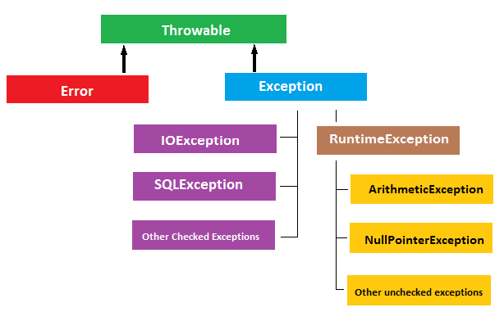
Java Exceptions Hierarchy
Java exceptions stay in the following class hierarchy:

Slide 27

Annotations
Java annotations add metadata to the class elements
Compiled in the class files
Accessible at runtime
Similar to the attributes in C# and .NET
@SuppressWarnings({ "unchecked", "rawtypes" })
private void myMethod() { … }
@Author(name = "Svetlin Nakov", date = "10/13/2014")
private void myMethod() { … }

Slide 28
Functional Programming in Java
Java 8 supports functional-style operations on streams of elements
Similar to the System.Linq extension methods in C#
Classes in java.util.stream package like Stream<T>
Lambda functions have similar syntax like in C#
Predicate<Integer> isDivisible = i -> number % i == 0;
private static boolean isPrime(int number) {
return number > 1 &&
IntStream.range(2, number).noneMatch(i -> number % i == 0);
}

Slide 29
Interfaces as Lambda
Interfaces can be implemented by lambda functions:
Shape[] shapes = new Shape[] { new Circle(5, 8, 12),
new Rectangle(3, 7, 10, 5), new Rectangle(5, 0, 2, 6) };
// Implementing Comparator<Shape> with anonymous class
Arrays.sort(shapes, new Comparator<Shape>() {
public int compare(Shape s1, Shape s2) {
return Double.compare(s1.calculateArea(), s2.calculateArea());
}
});
Arrays.sort(shapes, (s1, s2) ->
Double.compare(s1.calculateArea(), s2.calculateArea()));

Slide 30
Processing Streams of Elements
Processing streams in Java:
Processing sequences in C#:
List<Integer> values =
Arrays.asList(
1, 2, 3, 4, 5, 6, 7, 8);
System.out.println(
values.stream()
.filter(e -> e > 3)
.filter(e -> e % 2 > 0)
.map(e -> e * 2)
.findFirst()
);
// The same in C#
List<int> values =
new List<int>() {
1, 2, 3, 4, 5, 6, 7, 8};
Console.WriteLine(values
.Where(e => e > 3)
.Where(e => e % 2 > 0)
.Select(e => e * 2)
.First()
);

Slide 31
java.lang.Object
java.lang.Object is the base class for all Java classes, interfaces and enums
Silently inherited by all user types (like System.Object in C#)
Important virtual methods in java.lang.Object
equals(Object) – compares two objects for equality
hashCode() – calculates a hash code for using in hash tables
toString() – returns a String representation of the object
clone() – returns a copy of the object (like ICloneable in C#)

Slide 32
Iterable<T> and Iterator<E>
Iterable collections allow for-each traversal:
Default methods in interfaces add functionality to all subclasses
public interface Iterable<T> {
Iterator<T> iterator();
default void forEach(Consumer<? super T> action) { … }
…
}
public interface Iterator<E> {
boolean hasNext();
E next();
}

Slide 33
Comparable<T>
In Java comparing objects is done though the Comparable<T> interface
compareTo(obj) returns:
value < 0 – when this object is less than obj
value > 0 – when this object is greater than obj
0 – when this and obj are equal
public interface Comparable<T> {
int compareTo(T obj);
}

Slide 34

Summary
Java support classical OOP: classes and objects, fields, properties, methods, constructors, constants, access modifiers, encapsulation, static members, …
Java supports interfaces and abstract classes
Java supports inheritance and polymorphism
Java supports pseudo-generics with type erasure
Java supports exceptions, enumerations and annotations
Functional programming in Java:
Lambda functions, functional interfaces and streams

Slide 35
Object-Oriented Programming in Java
https://softuni.bg/trainings/coursesinstances/details/8

Slide 36
License
This course (slides, examples, demos, videos, homework, etc.) is licensed under the "Creative Commons Attribution-NonCommercial-ShareAlike 4.0 International" license
Attribution: this work may contain portions from
"OOP" course by Telerik Academy under CC-BY-NC-SA license

Slide 37







SoftUni Diamond Partners

Slide 38





Free Trainings @ Software University
Software University Foundation – softuni.org
Software University – High-Quality Education, Profession and Job for Software Developers
softuni.bg
Software University @ Facebook
facebook.com/SoftwareUniversity
Software University @ YouTube
youtube.com/SoftwareUniversity
Software University Forums – forum.softuni.bg

